Slide 1
Predicting Amazon Bestsellers
A Machine Learning Project

Slide 2
Agenda
Background and Problem Statement
Dataset Description and Preparation
Model Selection and Evaluations
Conclusions and Future Recommendations
Q & A

Slide 3
Background
Founded by Jeff Bezos in a garage, Amazon started as an online bookstore but rapidly expanded into various sectors.
Amazon opened its platform to third-party sellers in 2000, offering them a space to sell a wide range of items and leveraging Amazon's logistical infrastructure.
Sellers on Amazon benefit from additional services like warehousing, delivery, and inventory management, strengthening their relationship with the platform.
Retailers focus on identifying potential best-selling products with high demand on Amazon to optimize inventory management and increase profitability.

Slide 4

Problem Statement
How do you decide which product to sell on Amazon as a new seller?
This Photo by Unknown Author is licensed under CC BY-SA-NC
Notes:
10 Factors that decide bestsellers- top influencing - demand, competition, reviews and ratings

Slide 5
Data Understanding
Selecting the data source.

Slide 6
Dataset Description
Feature Label | Description | Data Type
SKU | A unique identifier code for each product. | Object (String)
Name | The name, brand, and model of the product. | Object (String)
Review_avg | The average review rating given on a scale of 0 to 5. | Numeric
Review_count | The total number of reviews on the product. | Numeric
Ranks | A string of all the different categories the product has a ranking in with the rank number. | Object (String)
Min_rank | The highest rank for the product across all categories. | Numeric
Max_rank | The lowest rank for the product across all categories. | Numeric
Ranks_count | Total number of categories it has ranked in. | Numeric
Offer | The cost of the product offered. | Numeric
Offers | The number of sellers offering the product. | Numeric
Tag1 | Tags related to the product. | Object (String)
Tag2 | Tags related to the product. | Object (String)
Request_date | The date the product was listed onto Amazon. | Object (Date)

Slide 7
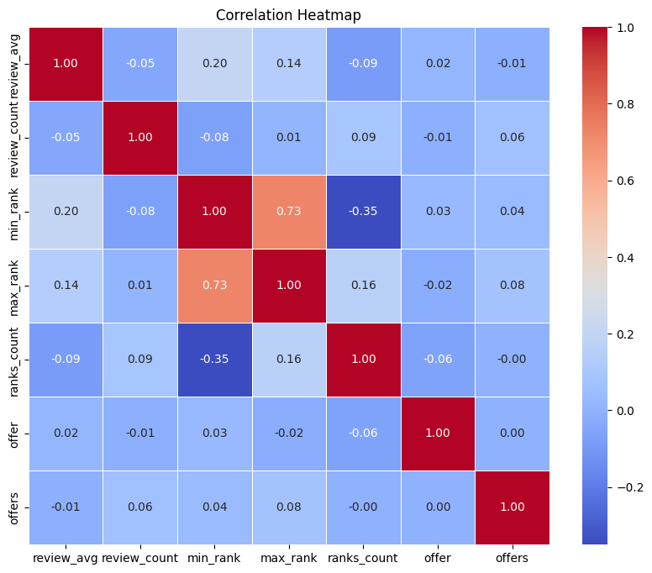
Correlation Map
Most significant features are ranks_count and max_rank

Slide 8

Data Preparation
The initial dataset had 13 columns with multiple missing values, non-numeric data types, varied scales and required layers of cleaning followed by normalization. Thus, this phase is divided into five sub-phases as follows:
Therefore, we now have six features and a min_rank as the target variable.

Slide 9
Model Choices and Selections
Model Type | Merits | Drawbacks
Linear Regression | Easy to interpret. Efficient for large sets of data. | Feature relationships are more complex and nonlinear.
K-Nearest Neighbors | Easy for prototyping and baseline modeling. Non-parametric thus versatile. | Expensive for large datasets. High sensitivity to noise and outliers.
Decision Tree | Captures complex non-linear relationships. Easy to visualize. | Apt for binary predictions or classification. Prone to overfitting.
Neural Networks | Flexible and Scalable. Can learn complex non-linear relationships. | Extremely complex. Black box nature. Features must be binary.
K-Means Clustering | Apt for identifying underlying patterns. | No target prediction. Sensitive to initialization.

Slide 10
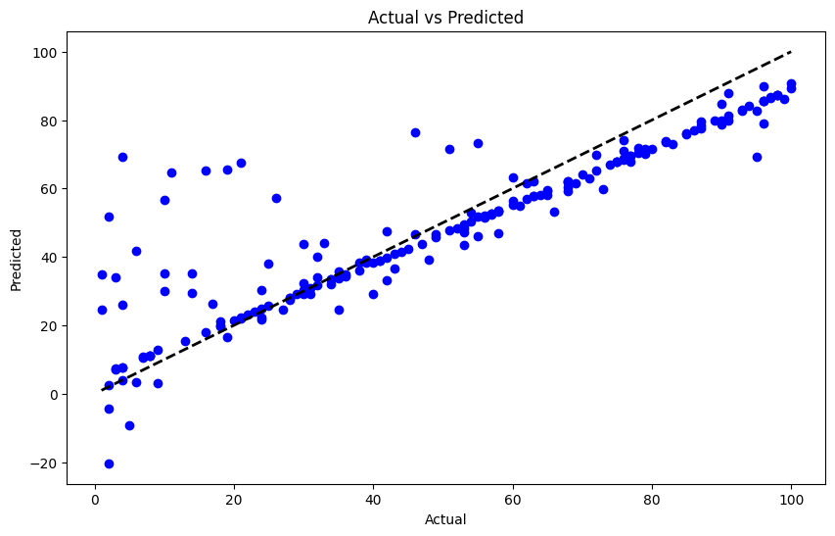
Linear Regression

Slide 11
K-Nearest Neighbor Classification
Starting with a simple 5 neighbor model produced a satisfactory training and testing accuracy of 89% and 83% respectively.
Upon performing Cross Validation for 5 folds the model performed slightly better at 8 neighbors after being optimized.

Slide 12
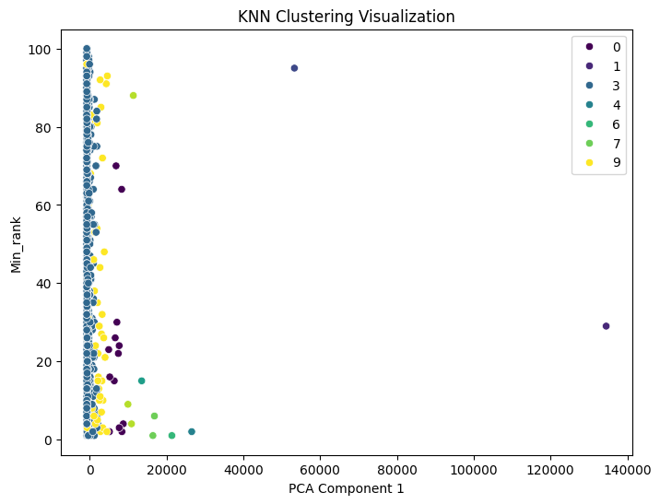
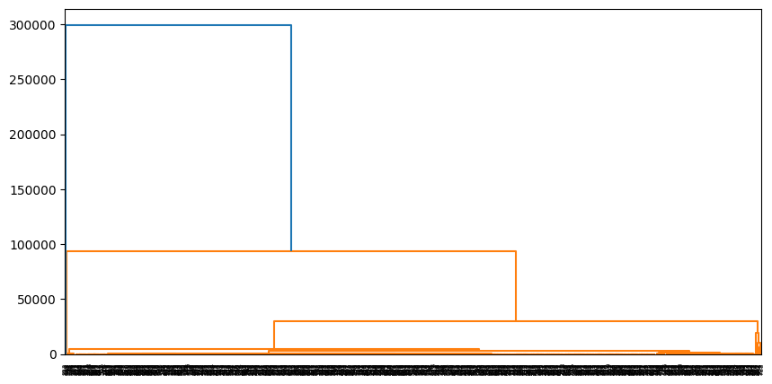
K-Means Clustering
Your ability to communicate effectively will leave a lasting impact on your audience
Effectively communicating involves not only delivering a message but also resonating with the experiences, values, and emotions of those listening

Slide 13
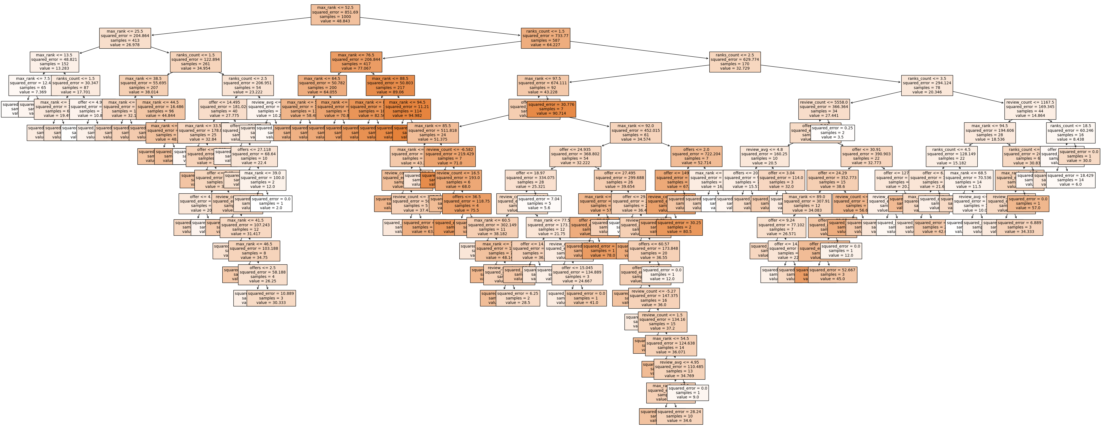
Decision Tree
Since the target is continuous the decision tree becomes complex and intricate.
This visualization is after using a leaf nodes threshold of 100.
The training error was ~4 and the accuracy was 99%.
The testing accuracy was 84%.

Slide 14
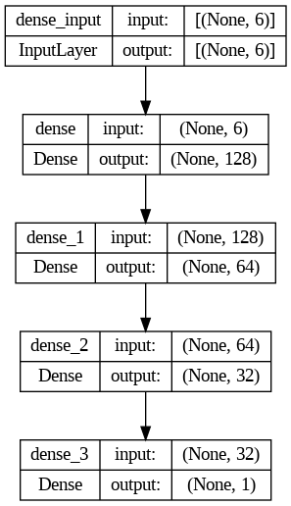
Neural Network
Training MSE: 157
Testing MSE: 205

Slide 15
Improvements and Recommendations
Explore the neural network analysis and fine tune the model.
The dataset was too small. We need a larger, diverse more recent dataset.
Different categories have different parameters for bestsellers we need to be modelled separately.
Can Web Scrape Dataset for real time data.
Leverage NLP techniques.
Perform Sentiment Analysis on the reviews.
Use consumer demographics to specialize predictions in different regions.

Slide 16
Thank you
Presented by:
Aarushi Talati
20022212

